Slide 1
IMAGE CAPTION GENERATOR APP
Final project
_____________________
רשא חג יחיא
בסנתי כמאל
ג׳נא אגבאריה
מנחה-ד"ר קגן גרשון

Slide 2
About The App
We created an app that receives images through the camera or gallery and it generates a caption for them and then it saves the image with the caption as a name to it

Slide 3

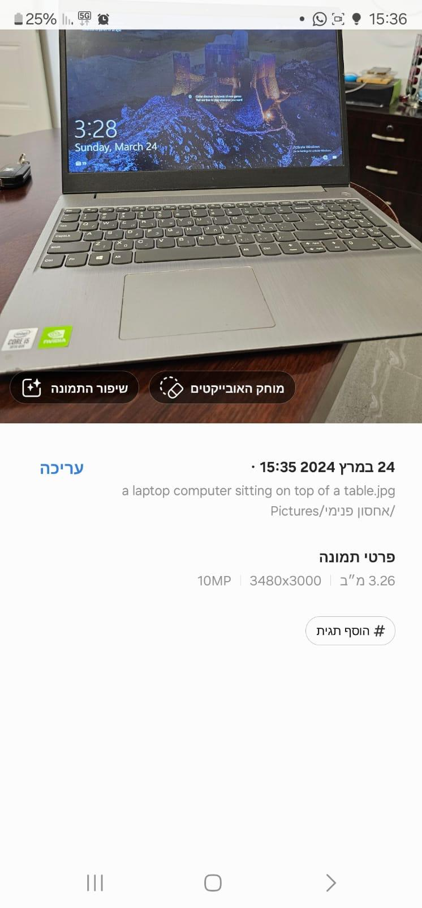
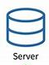
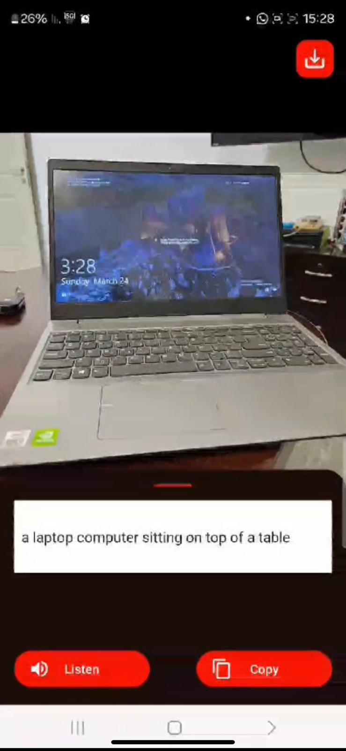
a laptop computer sitting on top of a table
1010.jpg

Slide 4
MOTIVATION
Instead of having a photo with a non-descriptive name, our app provides a meaningful name that captures the essence of the image.
We can develop an app for people with low vision that assists them with objects that are slightly out of their visual range. Users can simply take a picture, and the app will vocalize a description of the image. Additionally, they can save the picture, copy it, or share it with others."

Slide 5
IMAGE CAPTION GENERATOR MODEL USING CNN AND LSTM

Slide 6
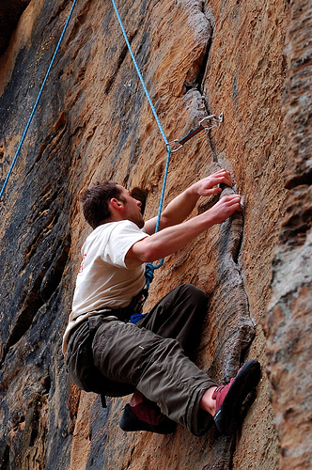
DESCRIPTION
Goal is to generate a descriptive sentence of an image
Neural
Network
A man climbs a rocky wall

Slide 7
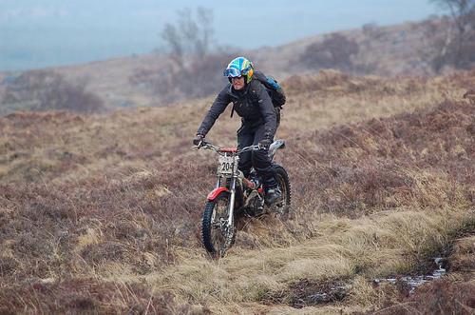
DATASET
We used Flickr30K dataset for this project
Flickr30K dataset contains a variety of images depicting scenes and situations
The dataset consists of more than 30k images and each image has 5 corresponding descriptions
We use the whole data for training
A man riding his bike on a hill
A man with helmet and backpack standing on dirt bike in a hilly grassy area
A person rides a motorbike through a grassy field
Man on motorcycle riding in dry field wearing a helmet and backpack
The biker is riding through a grassy plain .

Slide 8
TEXT PRE-PROCESSING
Each description is tokenized and converted to lowercase
Removed alpha-numeric characters and punctuation marks
We use startseq and endseq as prefix and postfix for each caption respectively
Filtered out unique words from the corpus and represented each word by an integer
To generate a fixed length word vector we calculated the maximum length caption

Slide 9
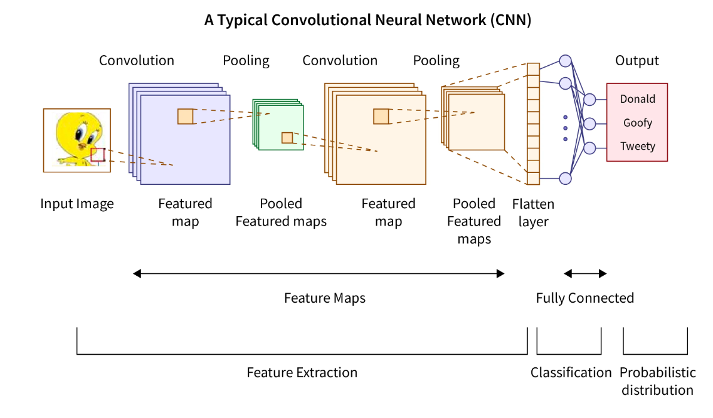
IMAGE FEATURE GENERATION
Resized all images to a fixed size of 299x299
Employed transfer learning using pre-trained Xception CNN model to encode images
We removed the last softmax layer from the Xception network to extract 2048 image vector

Slide 10
SEQUENTIAL CAPTION INJECTION
For each image we will train the model by temporally injecting incremental sequences of the description
In this phase, we essentially create labels in our training data
Image | Partial Caption | Target Word
Image | startseq | A
Image | startseq a | Young
Image | startseq a young | boy
…… | …… | ……
Image | startseq a young boy wearing a helmet and riding a bike in a park | endseq

Slide 11
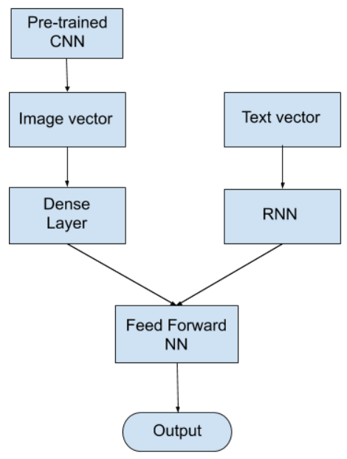
ARCHITECTURE
We used an encoder-decoder architecture
2048 image vector is fed to a Dense layer to generate 256 length image vector
72 length word vector is fed to LSTM/RNN to output 256 length word vector
Decoder model adds both the encoder outputs and is fed to Dense 256 layer
The last Dense layer will have as many nodes as the vocabulary size
The last softmax layer predicts the next word present in the output vocabulary

Slide 12
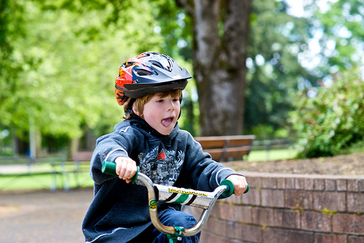
GENERATING PREDICTIONS
Caption is predicted word by word
Image is fed along with the first word(startseq) to the LSTM to predict the second word
Again the same image along with first word + second word is fed to the LSTM to predict the third word and so on until the last word(endseq) is encountered
Neural Network
model
Target Word
(i=0) little
(i=1) boy
(i=2) ….
(i=0) startseq
(i=1) startseq little
(i=2) …..

Slide 13
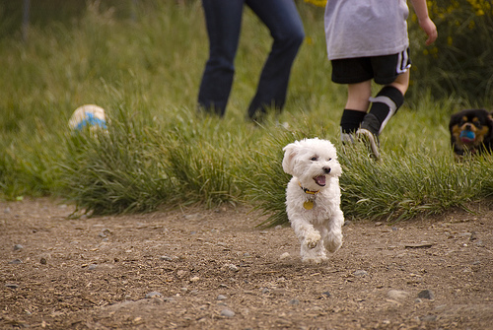
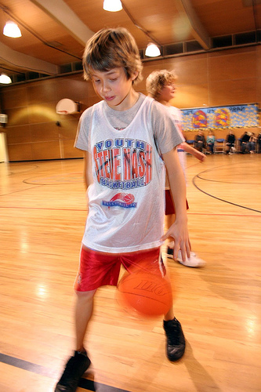
RESULTS
Images from the dataset
Actual Caption:
a boy with a blue helmet is riding a bike
Predicted Caption:
little boy rides bike with helmet
Actual Caption:
white fluffy dog running in the dirt
Predicted Caption:
white dog runs across the sand
Actual Caption:
a boy dribbles a basketball in the gymnasium
Predicted Caption:
boy in white shirt is playing basketball

Slide 14
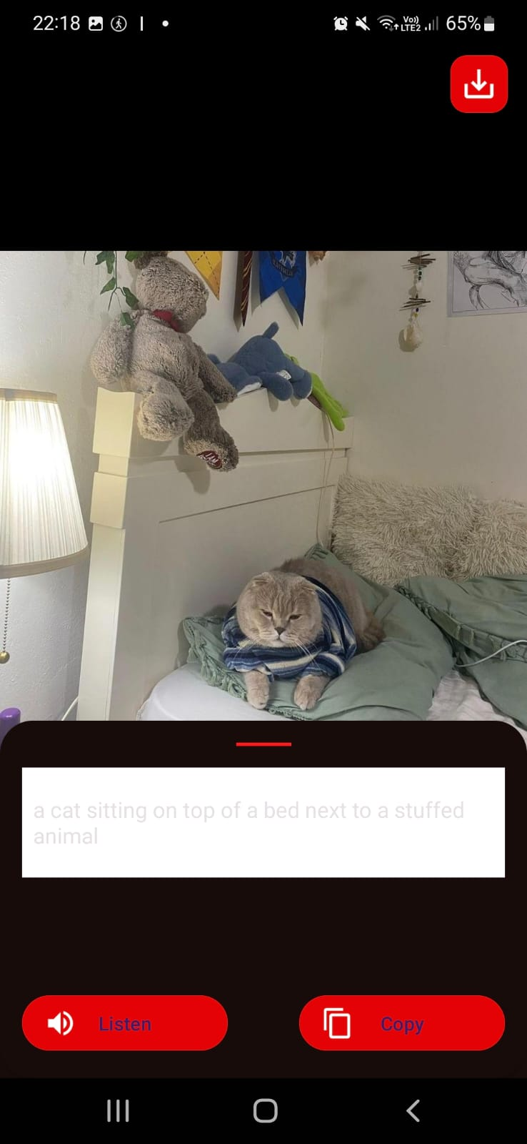
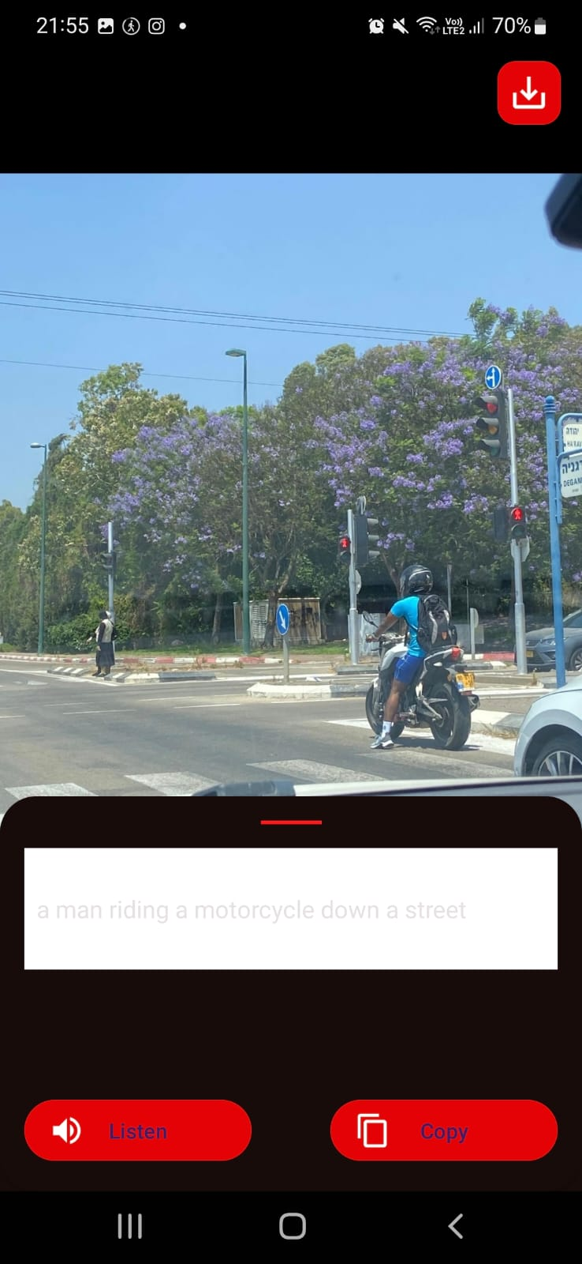
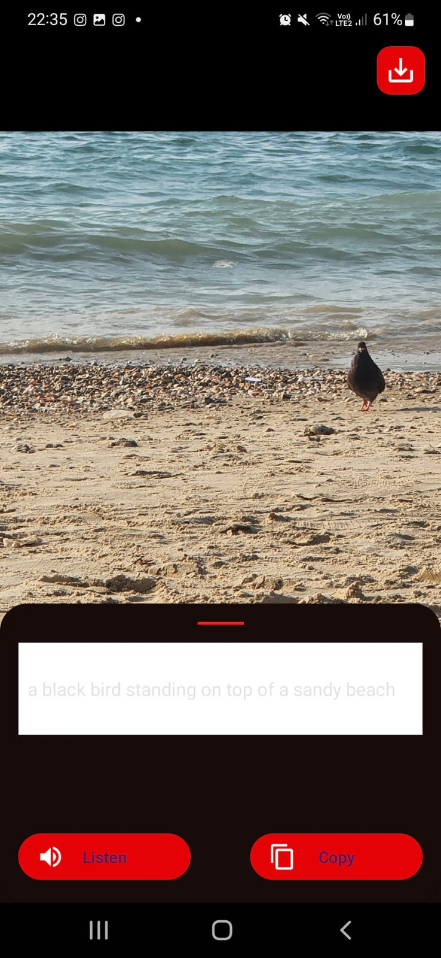
RESULTS
Images from my camera
A cat sitting on top of the bed next to a stuffed animal
A man riding a motorcycle down a street
A black bird standing on top of a sandy beach

Slide 15
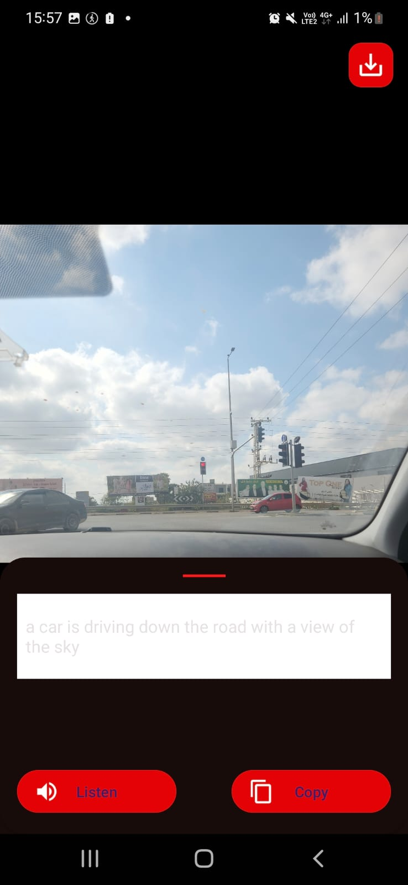
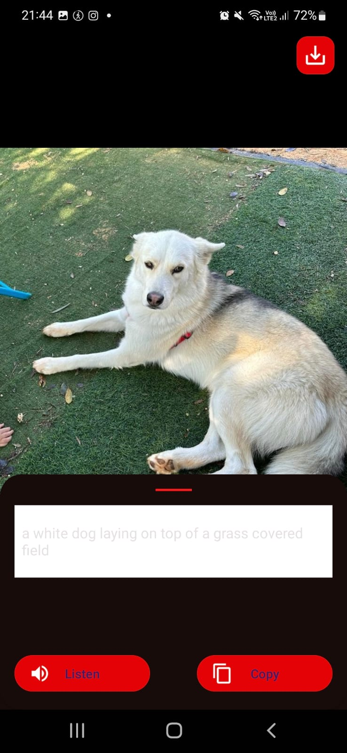
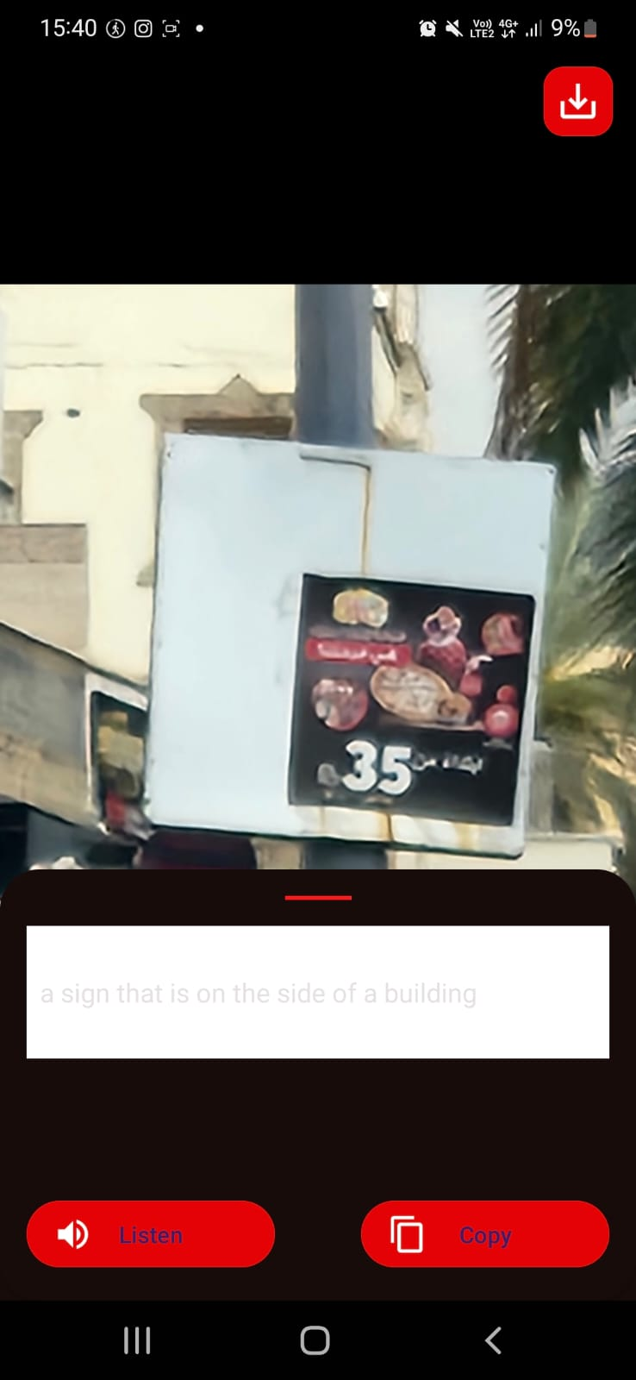
RESULTS
More images with their captions
A car is driving down the road with a view of the sky
A white dog laying on top of a grass covered field
A sign that is on the side of a building

Slide 16


Login and Register using shared preferences

Slide 17

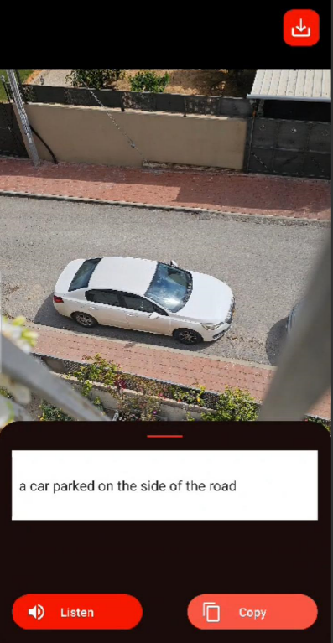
Adjustable font size and Audio captioning
to help those with low vision

Slide 18

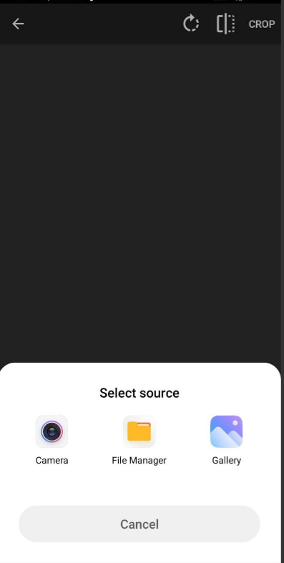
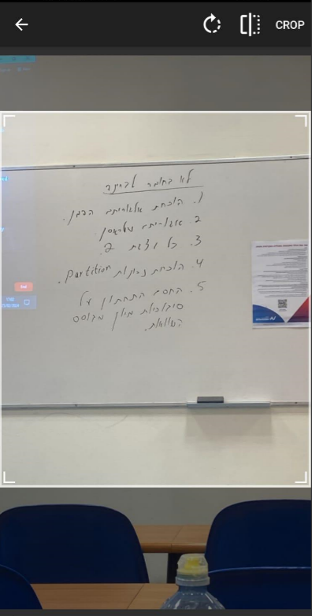

Slide 19
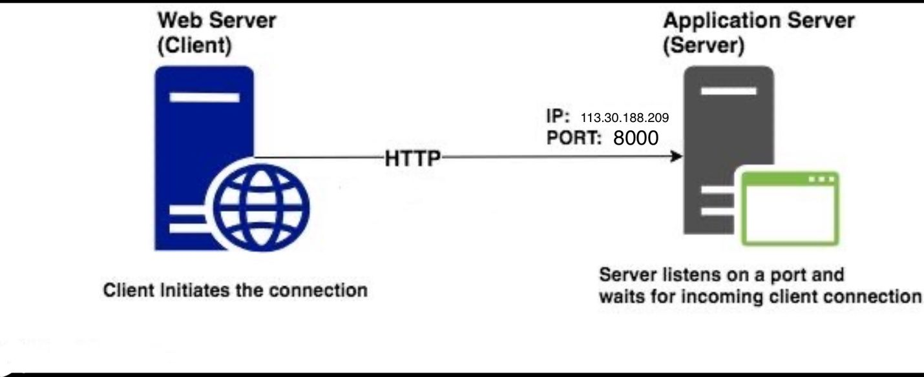


Slide 20


Slide 21








Slide 22
THANK YOU

